Slide 1




Movie Recommendation System

Slide 2
Contents
Introduction
Objectives
Scope
Literature Survey
Algorithm Used
Proposed System
Project Outcomes
Block Diagram
Use Case/DFD
Technology Stack

Slide 3

A movie recommendation system, or a movie recommender system, is a ML-based approach to filtering or predicting the users’ film preferences based on their past choices and behavior.
Problem Identified :
It becomes hard for the system to determeine if the user liked the movie they watch or they never liked it because user never left any ratings.
Solution Proposed :
Movie recommandation system will suggest the movie that matches the similarities of previous watched movies.

Slide 4

To find the best algorithm that will recommend movies based on their ratings.
To make the system in such a way that it has easy user- interface.
To provide a mechanism to assist users in classifying users with similar interests.
To create a platform which includes reviews, rating and can make comaprisions on movies.
To let the user have a login user id and password to secure their account.
Providing a streaming websites which totally free of cost which has free subscription.

Slide 5

The primary goal of movie recommendation systems is to filter and predict only those movies that a corresponding user is most likely to want to watch.
The ML algorithms for these recommendation systems use the data about this user from the system’s database. This data is used to predict the future behavior of the user concerned based on the information from the past.
The target of our proposed system is to recommend appropriate movies to the users according to the ratings of the other users provided they are in same cluster.

Slide 6

Sr.no | Title | Author(s) | Year | Algorithm | Limitations | Result
1 | An improved collborative Movie | Zang Wang et. al | 2014 | Content-Based Filtering | The study did not mention any evaluation metrics or | Hybrid approach reduces computation
 | Recommendation |  |  |  | experiments to validate the | complexity by date
 | System using |  |  |  | effectiveness and accuracy of | reduction technique
 | Computational |  |  |  | their recommendation system. | Fuzzy weighting is
 | Intelligence, |  |  |  |  | fast ,effective and
 |  |  |  |  |  | improves performance
 |  |  |  |  |  | of CRC.
2 | Content-Based Movie | Shaili Sen1, Prof. Pradeep | 2021 | Genre based filtering | The study did not evaluate the system's scalability and | The distribution method adopted to
 | Recommendation | Tripathi. |  |  | efficiency in handling a large | implement this is
 |  |  |  |  | number of customers and | focused on genrebased
 |  |  |  |  | cake options. As the number | filtering. In this case,
 |  |  |  |  | of customers and cakes | the dataset that was
 |  |  |  |  | increases, the | used for the project is
 |  |  |  |  | recommendation system's | Movie Lens. Python is
 |  |  |  |  | performance and accuracy | the research software
 |  |  |  |  | may decrease, which can | used
 |  |  |  |  | affect the user experience and
 |  |  |  |  | the system's adoption rate.
3 | FARS: Fuzzv Ant based Recommender | Ming He ,Bo Wang | 20111 | Genre based filtering | Customers may forget to update their preferences or | It is a data-driven recommendation
 | System |  |  |  | may not be aware of the new | system that delivers
 |  |  |  |  | cake options that match their | recommendations to
 |  |  |  |  | occasions. The | customers, such as
 |  |  |  |  | recommendation system's | books, films, etc. Most
 |  |  |  |  | accuracy may be limited by | movie recommendation
 |  |  |  |  | the reliability of customers' | systems normally base
 |  |  |  |  | self-reported data. | user preferences on
 |  |  |  |  |  | similar films.

Slide 7
Cosine Similarity
5. Algorithm Used
Cosine similarity is a measure of similarity between two non-zero vectors in a multi-dimensional space. In the context of recommendation systems, cosine similarity is often used to measure the similarity between the item profiles and user profiles in a content-based filtering system.
In the context of content-based filtering, cosine similarity is used to compare the similarity between two item profiles or between an item profile and a user profile. The item profiles and user profiles are represented as vectors, where each feature or characteristic of an item or user corresponds to a component in the vector. The cosine similarity between two vectors is then calculated using the formula above.

Slide 8
6. Proposed System
Problem Statement:
Online streaming services have become increasingly popular over the past few years, providing users with a vast selection of movies and TV shows. However, with so many options available, it can be overwhelming for users to find content that suits their preferences.
The goal is to design and develop a user-friendly streaming website that utilizes recommendation algorithms to help users discover new and relevant content, while also providing them with a seamless viewing experience.

Slide 9
7. Project Outcomes:
User can register and login themselves
Improved user engagement, retention and experience.
The user can watch the movies and content media as per interest
Media contains the varieties of movies, devotional, cartoons, series, inspirational video
The user will have recommendation updates as per their interest according to their watch history & preferences.
The User can also submit their grievance and feedbacks.*

Slide 10
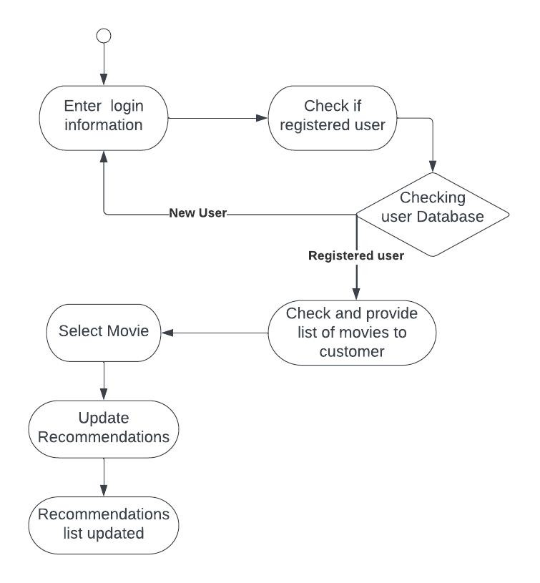
8. Flow chart

Slide 11





9.Use Case Diagram:
Registration
Login
View Movies
Rating and Get recommendation
User
Logout

Slide 12
10. Technology Stack :
Web Technologies
HTML
CSS
Javascript
Django
Bootstrap
Machine Learning in libraries used in python:-
Database Mongo-DB
Numpy, Pandas, Scipy
ML (Visual Studio)

Slide 13
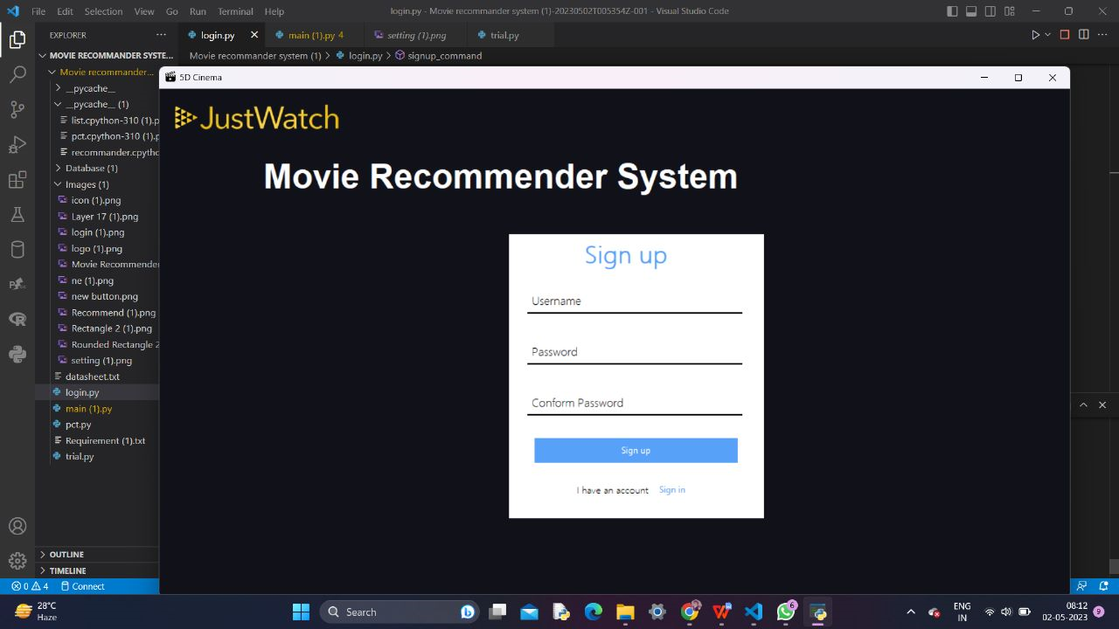
Login.py

Slide 14
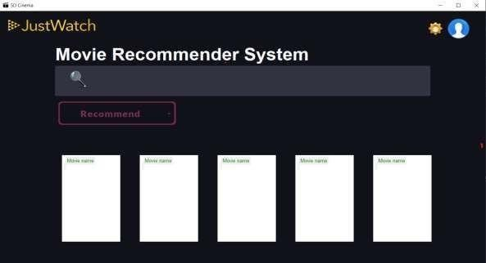
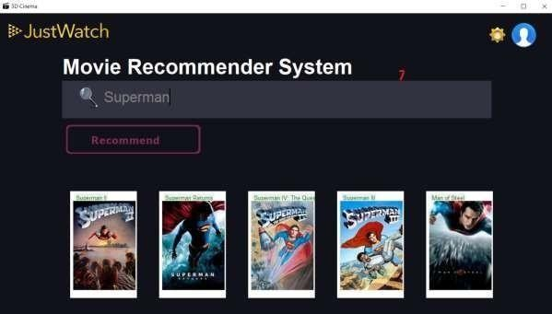
Main.py

Slide 15
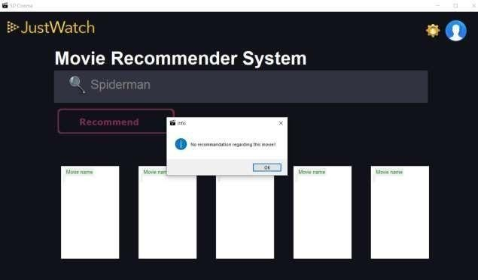
Main.py

Slide 16
Thank You...!!

